Slide 1
COM4012M Programming 02 Programming for the Web
Dr Soumya Banerjee, Senior Lecturer in Computer Science
Contact:s.banerjee@yorksj.ac.uk
Introduction
Week 1

Slide 2
Module overview

Slide 3
Session Frequency and Schedule
Sessions are held once a week on Fridays.
Lecture:
Time: 9:00 - 10:00
Location: DT102/DT103
Lab sessions:
Time: 10:00 - 13:00
Location: DT102/DT103
Supplemental Self-Directed Learning (SOL) sessions:
Time: 13:30 - 15:00
Location: DT102/DT103

Slide 4
Module overview
Module Leader:
Dr. Soumya Banerjee; s.banerjee@yorksj.ac.uk
Please use your York SJ email and include COM4012M in the email subject.
Lab supervision
Alec Wells; a.wells1@yorksj.ac.uk
& Soumya

Slide 5
Module overview
The lecture sessions are more theoretical and focus on aspects of software engineering and web design
The lab sessions deal with the actual development of web sites and multimedia.
Worksheet
Other resources – W3S

Slide 6
Module Overview: Theory
The User Experience
Strategy and Requirements
Content and Specification
Interaction Design
Information Architecture
Interface Design
Visual Design
Usability: is about designing products to be effective, efficient, and satisfying. Usability includes user experience design.
Accessibility: Web accessibility means that people with disabilities can equally perceive, understand, navigate, and interact with websites and tools.
https://www.w3.org/

Slide 7
Module Overview: Practical
HTML (HyperText Markup Language) – Content of webpages
CSS (Cascading Style Sheets) – Presentation & styling
JavaScript – Clientside scripting
PHP – Serverside scripting
MySQL – Database integration

Slide 8
Assessment
100% assessment base
Website development
Design
Implementation
Presentation – how does it look
Development and testing (source files)

Slide 9
Introduction

Slide 10
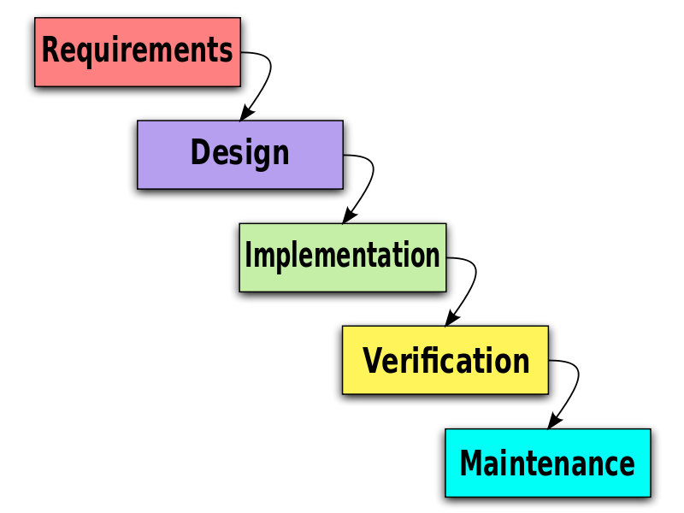
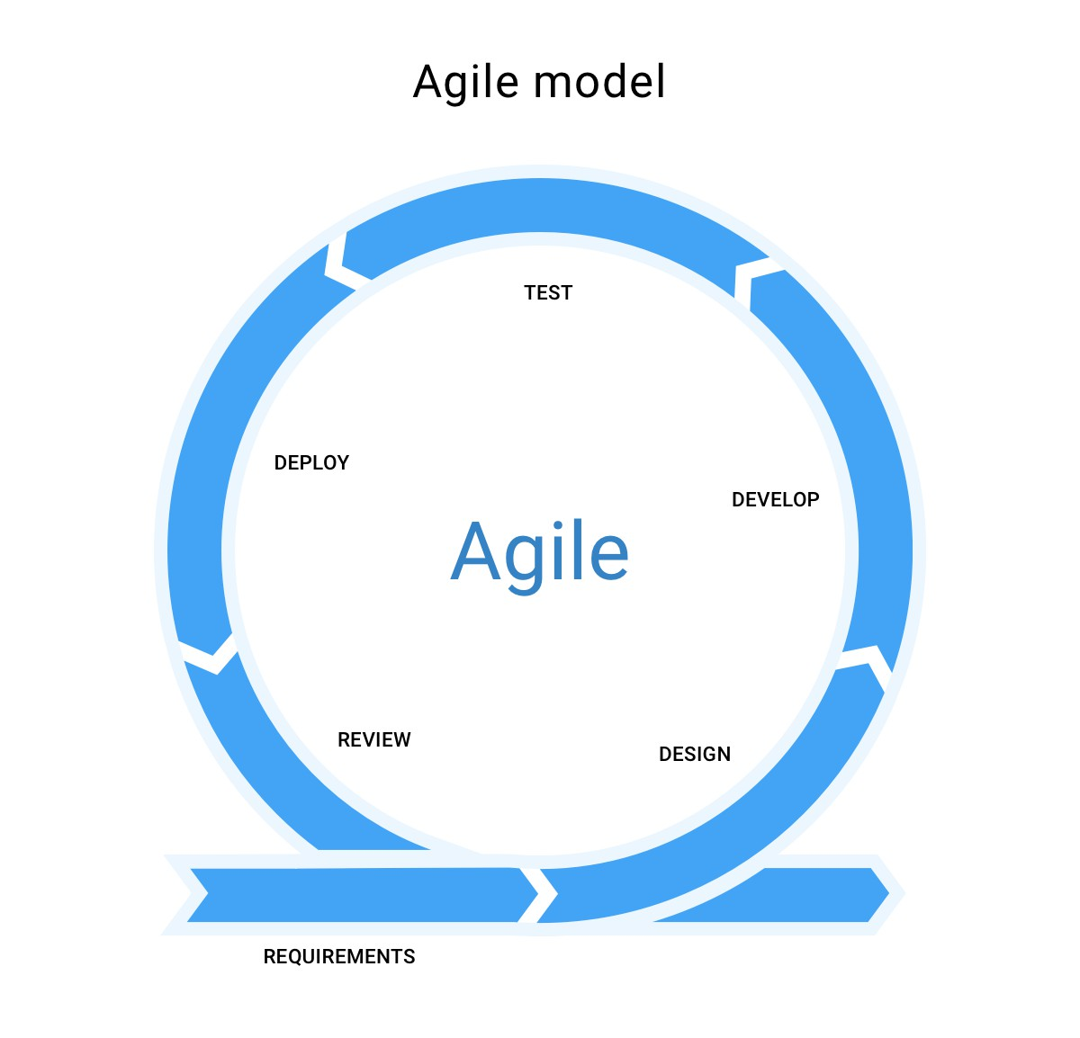
Introduction
This module is about Software Engineering for the Web.
Software Engineering design and development methodologies (Waterfall, Prototyping , Agile manifesto etc…), what this module focusses on is an approach to the design of Web Systems.
This approach is called the User Experience (UX) and User Experience Design (UXD)

Slide 11
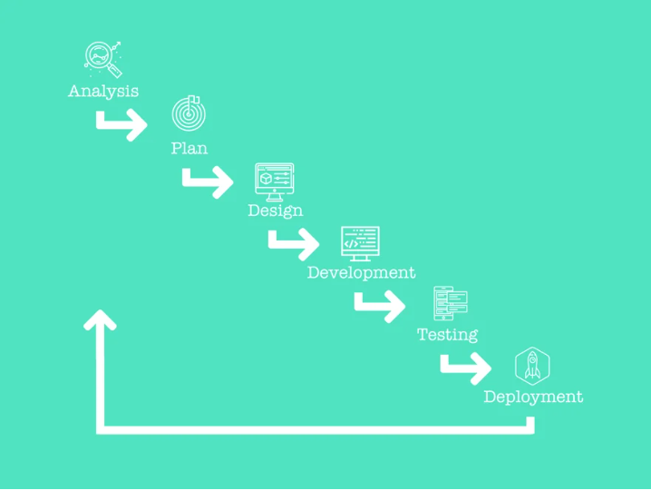
Waterfall
The waterfall method is moving from one phase to another, one at a time, without revisiting the completed phases until all other phases are complete.
Source: Agile Web Design vs Waterfall Web Design | Growth Driven Design

Slide 12
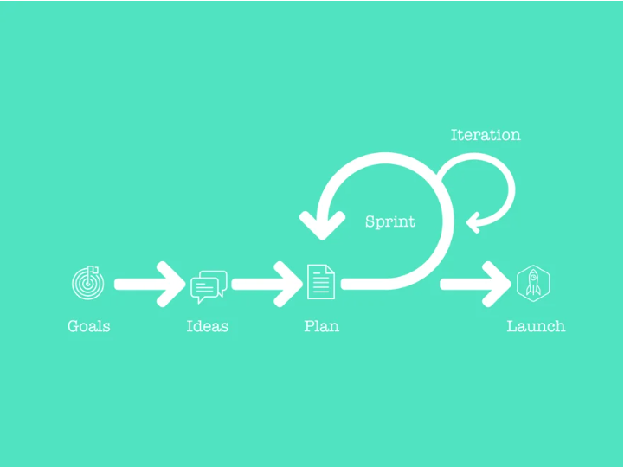
Agile
The agile process is about getting something to market very quickly, even though it might not be ready for prime time, so you can iterate and make the best changes to optimise the product.
Source: Agile Web Design vs Waterfall Web Design | Growth Driven Design

Slide 13
UX Design
UX Design brings together many of the different elements of web design into a structure that enables you to consider the design of all aspects of web applications together.
The foundational concepts of design can be traced back to the 1940s.
Notably, Don Norman is credited with coining the term "User Experience" in the early 1990s.

Slide 14
The User Experience
The development of User experience (UX) is about making sure every part of how a user interacts with your website or app is exactly what you want them to experience.
It means thinking about what the user might want to do, and what they might expect to happen, at every point. You consider all the different actions they might take and design your website or app to make it easy and enjoyable for them.

Slide 15
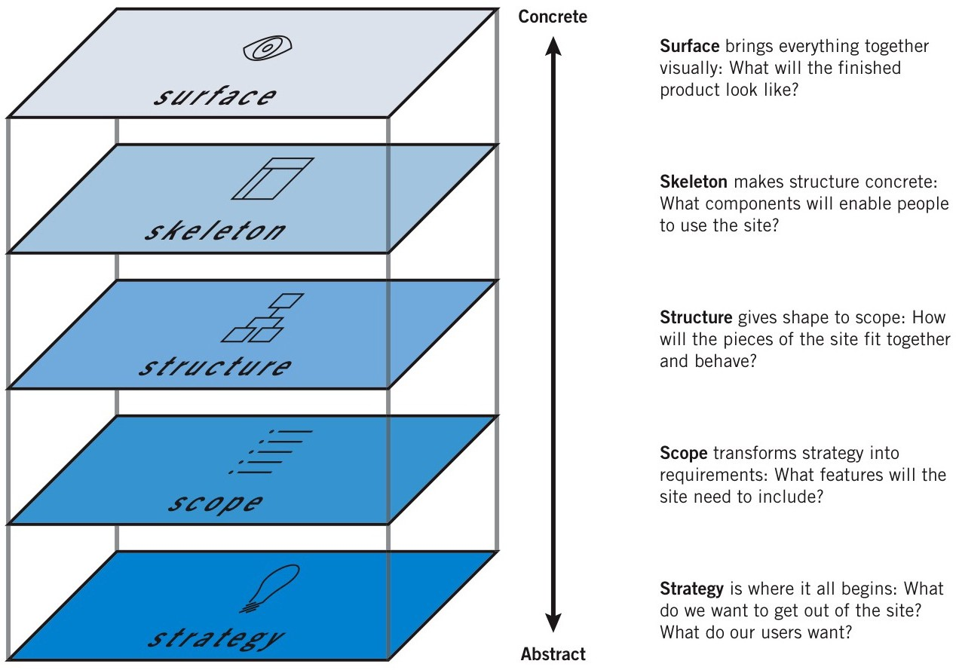
The Elements of UX
Source: Jesse James Garrett, 2002

Slide 16
The Elements of UX
This framework helps designers understand the different aspects of user experience and how they interrelate.
Each plane builds upon the previous one, starting with the overall strategy and moving down to the
visual design of the interface.
Plan your project so that work on each plane is completed before moving to the next.
🤔 When the Web started, there were two groups of people:
one saw Web pages as documents (and applied principles from traditional media such as publishing)
the other saw them as applications (and applied principles from desktop applications).
Today, most Web sites are a mixture of both.
Source: Jesse James Garrett, 2002

Slide 17
Duality of Web
Web as Document: Focuses on delivering content, such as articles, images, and videos.
The primary goal is to inform or entertain the user.
Web as Application: Emphasizes tasks: interactivity and functionality,
allowing users to perform tasks such as filling out forms, making purchases,
or using web-based software.
Designers must balance these two aspects to create effective and engaging web experiences.
Source: Jesse James Garrett, 2002

Slide 18
User interface design principles
Source: Ian Sommerville, 2000, Software Engineering 6th edition

Slide 19
Usability
The primary notion of usability is that an object is designed with the users' psychology and physiology in mind.
“Usability is a quality attribute that assesses how easy user interfaces are to use. The word "usability" also refers to methods for improving ease-of-use during the design process”. (Jakob Nielsen, 1993)
J. Nielsen. “What is Usability” in Usability Engineering, An Imprint of Academic Press, 1993, pp.26

Slide 20
Key Usability Goals
Efficient to use [efficiency]
Safe to use [safety]
Easy to learn [learnability]
Easy to remember how to use [memorability]
How pleasant to use [satisfaction]

Slide 21
Key Usability Goals
Efficiency: how does system support users in task completion? Unwritten 3 click rule.
Safety: protection from dangerous conditions [ergonomic concerns] & undesirable actions [error prevention]
Learnability: how easy to learn & use?
Memorability: how easy is it to remember how to use once learned?
Satisfaction: How much users find the system appealing

Slide 22
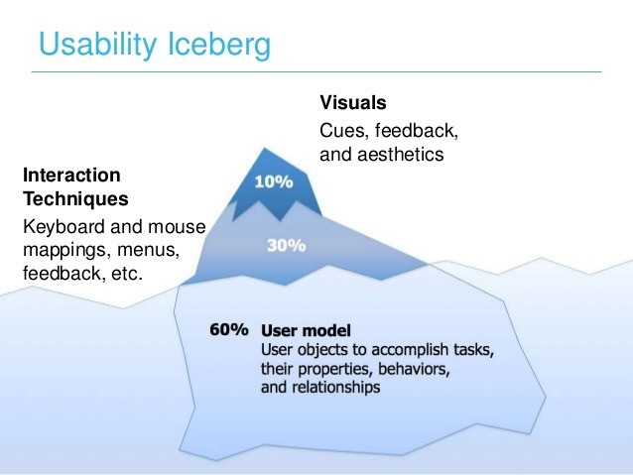
Usability
Image source: image.slidesharecdn.com

Slide 23
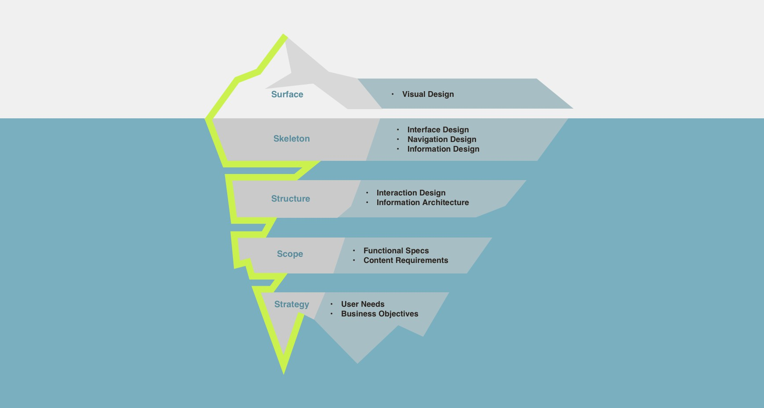
Usability and the UX
Image source: tobiasandtobias.com

Slide 24
Accessibility
Web accessibility often means that people with disabilities can use the Web.
More specifically, Web accessibility means that people with disabilities can perceive, understand, navigate, and interact with the Web, and that they can contribute to the Web.
Read more on: Introduction to Web Accessibility, W3C

Slide 25
Accessibility
The Web is an increasingly important resource in many aspects of life: education, employment, government, commerce, health care, recreation, and more.
https://www.gov.uk/guidance/accessibility-requirements-for-public-sector-websites-and-apps
https://siteimprove.com/en-gb/accessibility/uk-accessibility-laws/
An accessible Web can also help people with disabilities more actively participate in society.
It is essential that the Web be accessible in order to provide equal access and equal opportunity to people with disabilities.
Read more on: W3C

Slide 26
Accessibility
Web accessibility also benefits people without disabilities.
For example, a key principle of Web accessibility is designing Web sites and software that are flexible to meet different user needs, preferences, and situations.
One example for improving accessibility is to choose colour palettes suitable for people with colour vision deficiency (e.g. using ColorBrewer).

Slide 27
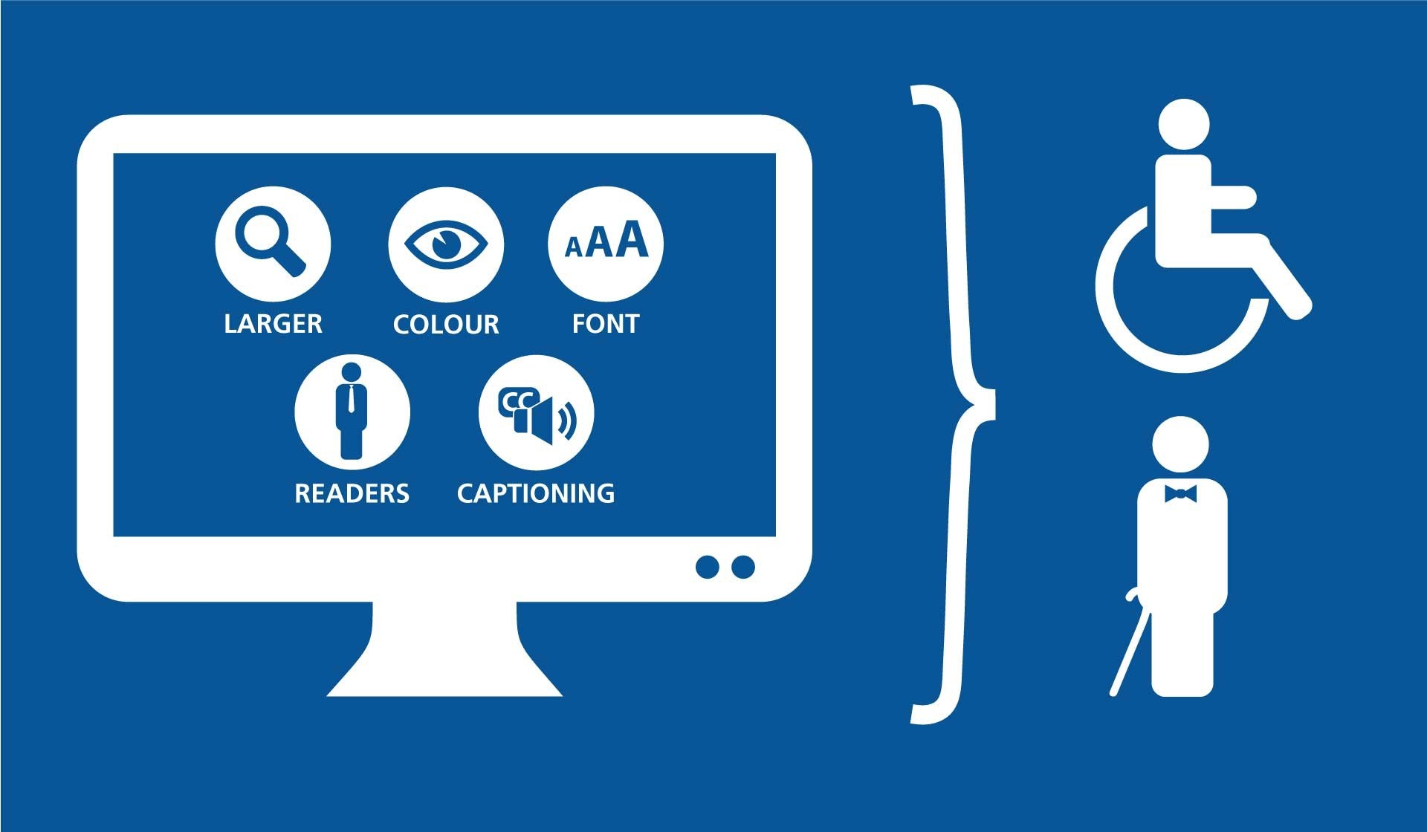
Accessibility
Image Source: kinexmedia.com

Slide 28
Summary
This module will focus on the User Experience of Web Design. This is a framework that brings together all aspects of web design.
Alongside this, cutting across almost all aspects of the Web Design is usability and accessibility. These two are fundamental issues in Web Design.
Finally, applying certain techniques to implement the design in real websites working in accordance with the design principles and quality measures

Slide 29
References & Additional Reading
Reading & research:
The User Experience: The Elements of User Experience http://www.jjg.net/elements/pdf/elements_ch02.pdf
Usability: Nielsen Norman Group www.useit.com
Accessibility: W3C Web Accessibility Initiative www.w3c.org/wai
Additional reference of interest:
Williams R (2001) Web Design Workshop. Peachpit Press
Jakob Nielsen and Hoa Loranger (2006) Prioritising Web Usability. New Riders Press

Slide 30
Exercise: Assess web site design
You have 15 minutes to review the web page designs from the following list. Please identify and compile a list of at least 5 to 6 positive aspects and 5 to 6 areas for improvement.
Feedback to the whole group

Slide 31
Example Sites
http://themagicofbaltimore.blogspot.co.uk/
https://www.sphere.bc.ca/oldsite/index.html
http://www.libertyvan.com/
http://www.gatheringofnations.com/
https://www.pennyjuice.com/
http://arngren.net
http://www2.pnwx.com
https://www.art.yale.edu/
http://www.007museum.com/
http://superfastnorthyorkshire.com
https://www.lingscars.com/

